Slide 1

PROJECT REPORT
By Slavvy Coelho

Slide 2

Microsoft

Slide 3

Overview :
Big data
is an umbrella term that describes the large volume of data – both structured and unstructured that inundates a business on a day-to-day basis
Big data can be analysed for insights that lead to better decisions and strategic business moves.
in the early 2000s when industry analyst Doug Laney articulated the now-mainstream definition of big data as the three V’s : Volume , Velocity & Variety
You can take data from any source and analyze it to find answers that enable
cost reductions
time reductions
new product development and optimized offerings and
smart decision making.
Notes:
3 V’s here stand for :
Volume. Organizations collect data from a variety of sources, including business transactions, social media and information from sensor or machine-to-machine data. In the past, storing it would’ve been a problem – but new technologies (such as Hadoop) have eased the burden.
Velocity. Data streams in at an unprecedented speed and must be dealt with in a timely manner. RFID tags, sensors and smart metering are driving the need to deal with torrents of data in near-real time.
Variety. Data comes in all types of formats – from structured, numeric data in traditional databases to unstructured text documents, email, video, audio, stock ticker data and financial transactions.

Slide 4

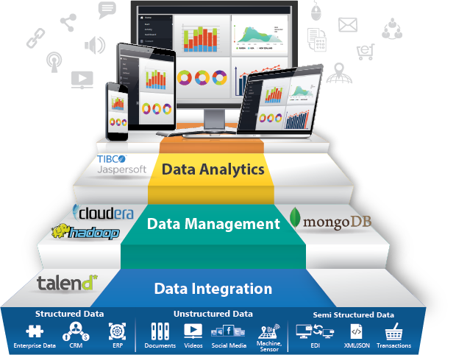

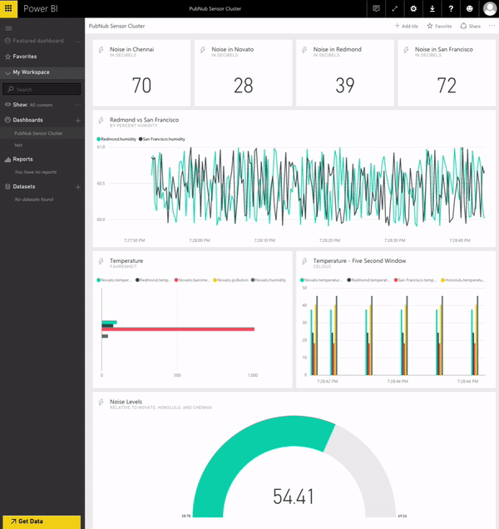
Notes:
Big data can be analysed with the software tools commonly used as part of Advance Analytics disciplines such as Predictive Analysis Data Mining, Text Analytics and Statically Method.
But the semi-structured and unstructured data may not fit well in traditional Data Warehouse based on Relational Database. As a result, many organizations looking to collect, process and analyse big data have turned to a newer class of technologies that includes Hadoop and related tools such as Yarn Spook, Spark, and Pig as well as No Sql databases( such as mongodb)
Mainstream BI software and Visualization tools can also play a role in the analysis process reason being in the end all this data can be viewed in a simplified notion and meaningful value maybe extracted for the same.

Slide 5
Data 🡪 Analytics 🡪 Visualisation
Why is data visualization important?
Because of the way the human brain processes information, using charts or graphs to visualize large amounts of complex data is easier than poring over spreadsheets or reports.
Data visualization is a quick, easy way to convey concepts in a universal manner – and you can experiment with different scenarios by making slight adjustments.
Data visualization can also:
Identify areas that need attention or improvement.
Clarify which factors influence customer behaviour.
Help you understand which products to place where.
Predict sales volumes.
Notes:
So here comes the role of Visualization tools such as Tableu, Wolfram alpha, Raw , Plotty ,Power BI etc
In my case I have worked on Power BI and various features associated to it.

Slide 6

End to end solutions

Slide 7



\
Power BI

Slide 8
Unlock insights on any data
Power BI overview
Turning data into a business advantage
Notes:
So that brings us to Power Bi

Slide 9
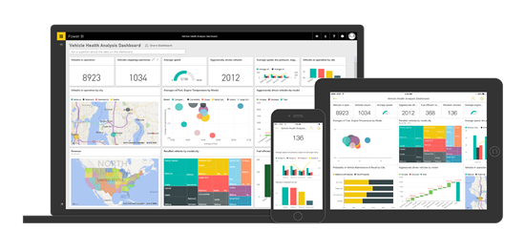

What is Power BI ?
Power BI is a suite of business analytics tools that deliver insights throughout your organization. Connect to hundreds of data sources, simplify data prep, and drive ad hoc analysis. Produce beautiful reports, then publish them for your organization to consume on the web and across mobile devices.

Slide 10
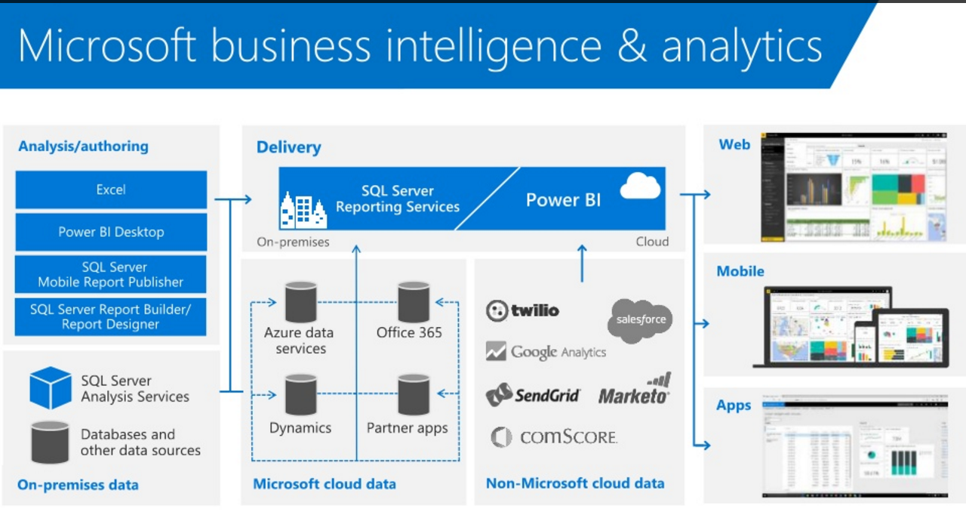

Slide 11

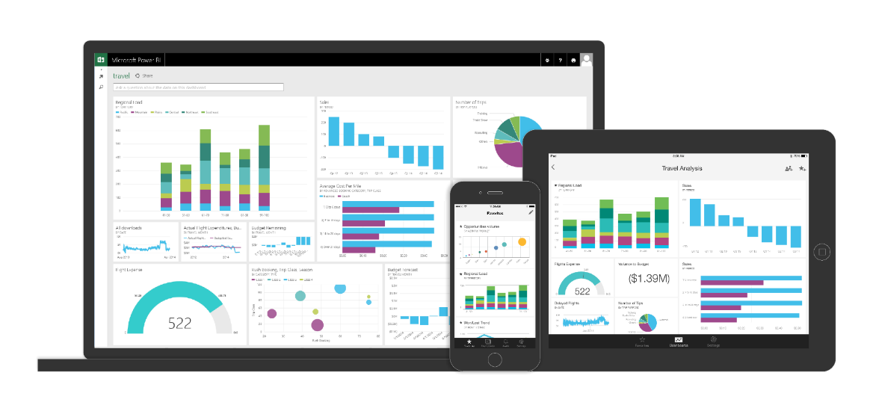
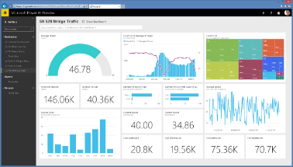





Key benefits and differentiators of Power BI
Pre-built dashboards and reports for popular SaaS solutions
Real-time dashboard updates
Secure, live connection to your data sources, on-premises and in the cloud
Intuitive data exploration using natural language query
Integrated with familiar Microsoft products and utilizes commitment for scale & availability in Azure
Fast deployment, hybrid configuration, secure, and integrated with existing IT systems.
Notes:
Key message:
There are several capabilities that differentiate Power BI from other offerings in the market.
Talking points:
Power BI is a cloud-based analytics service that provides faster time to insight. It is used for visualizing, exploring and extracting insights from data. It brings together data from diverse sources to deliver rich, comprehensive views of business operations.
What that means is, with Power BI, you can see all of your data through a single pane of glass, and create an analytics environment in minutes to monitor data and share reports. Live dashboards and reports show visualizations and KPIs from data that reside both on-premises and in the cloud, providing a consolidated view across your business regardless of where your data lives.
There are several capabilities that are unique to Power BI – these include:
Pre-built dashboards and reports for popular SaaS solutions such as Marketo, Salesforce, GitHub, ZenDesk, Dynamics CRM, and many others
Dashboards and visualizations that support real-time updates
Secure, live connection to on-premises data sources to drive insight across the entire range of organizational information (Analysis Services, Azure SQL Database, SQL Database Auditing, Azure SQL Data Warehouse)
Automated scheduled refresh to keep your Power BI data in sync with on premises data sources
Native mobile applications for keeping users connected on the go
Easy integration with other Microsoft offerings, from Excel to Azure services
Intuitive data exploration, which enables users to ask questions of their data in plain English
To summarize, Power BI is a SaaS offering that enables anyone to easily connect to their data, create live operational dashboards and explore data via interactive visualizations

Slide 12



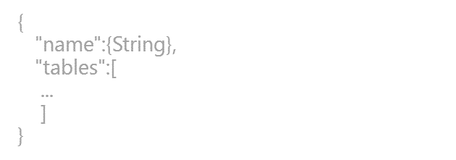
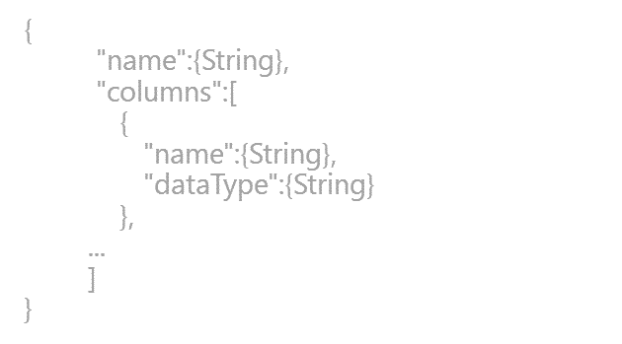
Power BI Overview
Power BI
Data sources
Power BI service
SaaS solutions
e.g. Salesforce, GitHub, Google
Content packs
Natural language query
Sharing & collaboration
On-premises data
e.g. Analysis Services
Live dashboards
Organizational content packs Corporate data sources or external data services
Visualizations
Azure services
Azure SQL, Stream Analytics…
Excel files
Workbook data / data models
Reports
01001
10101
Power BI Desktop files
Data from files, databases, Azure, and other sources
Datasets
0110001
00010110
Data refresh
Power BI Desktop
Power BI REST APIs
Prepare
Explore
Report
Share
Notes:
There is more….
3. Power BI Desktop is a visual data exploration tool that enables you to analyze data and create stunning reports. With Power BI Desktop, you are able to:
Acquire and prepare data using extensive query capabilities
Manipulation and consolidation of multiple data sources is performed in Power BI Desktop – this enables Power BI service users to use data from multiple sources in a single report
Establish data structure, then transform and analyze data
Visualize and explore your data in new ways through a freeform drag-and-drop canvas
Author reports with a broad range of modern data visualizations
Publish beautiful, interactive reports directly to powerbi.com
Securely share reports through unique, curated content library approach
4. Finally, the Power BI REST API library allows you to customize nearly every aspect of Power BI, including connecting to custom data sources, enabling real-time data streaming from your data source to Power BI, and integrating other applications with Power BI

Slide 13
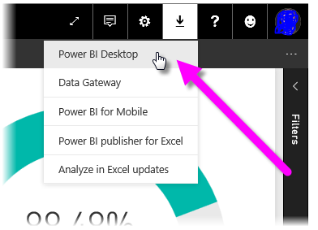
Installation of Power BI ?
After you have logged in with your credential's on your Power BI account you may download the most recent version of Power BI Desktop, you can select the download icon from the upper right corner of the Power BI service, and select Power BI Desktop.
Or Directly download Desktop
Power BI ( 32- or 64-bit versions).
From :
https://powerbi.microsoft.com/en-us/desktop/
Notes:
When we are registering for the Power BI on Microsoft page we require to give an official id not Gmail, yahoo or any other such email service.

Slide 14
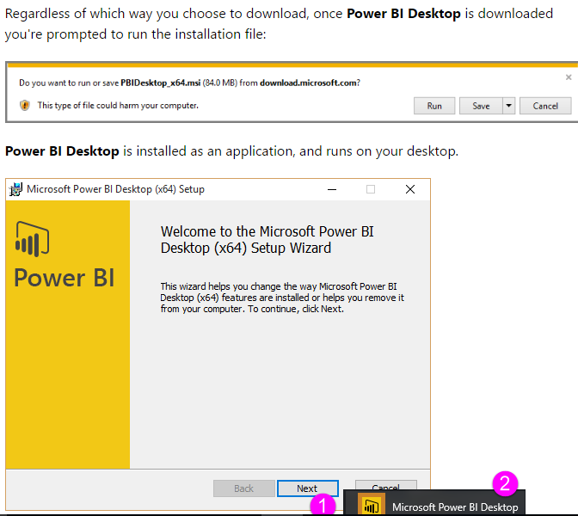
After the link is installed go forward with the setup
Notes:
After setup is completed click on the power bi desktop icon

Slide 15
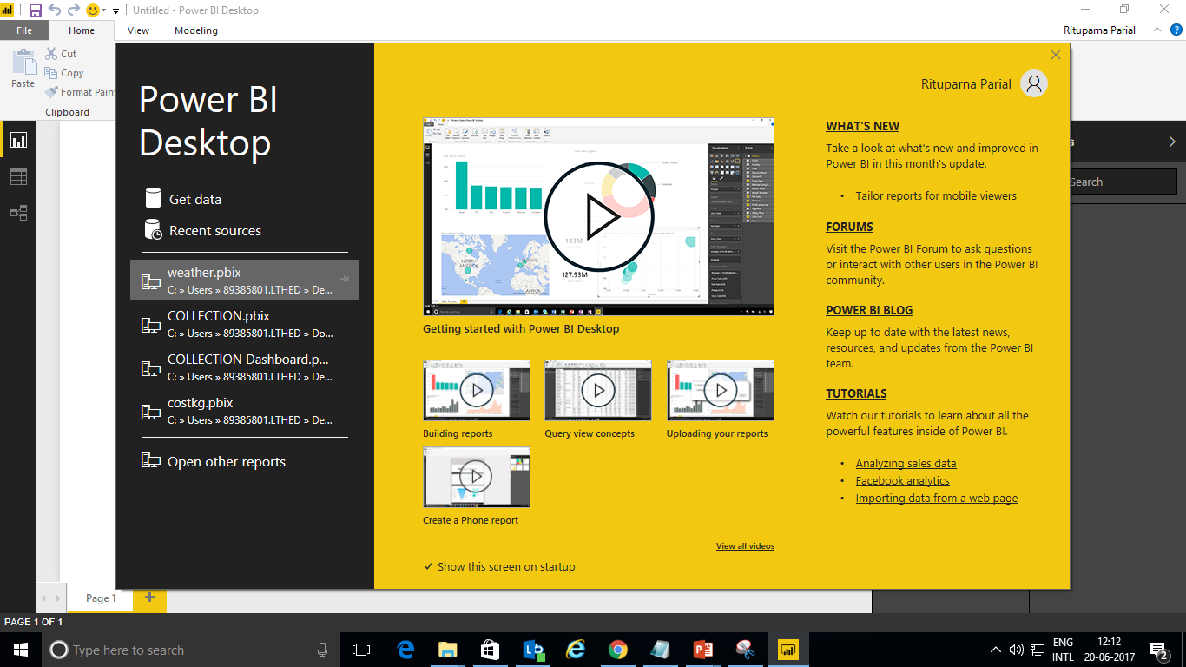
After the installation this window will be seen when we click on the Power bi Desktop icon
Notes:
You can Get Data, see Recent Sources, or Open Other Reports directly from the Welcome screen (from the links in the left pane). If you close the screen (select the x in the top right corner), the Report view of Power BI Desktop is displayed.

Slide 16
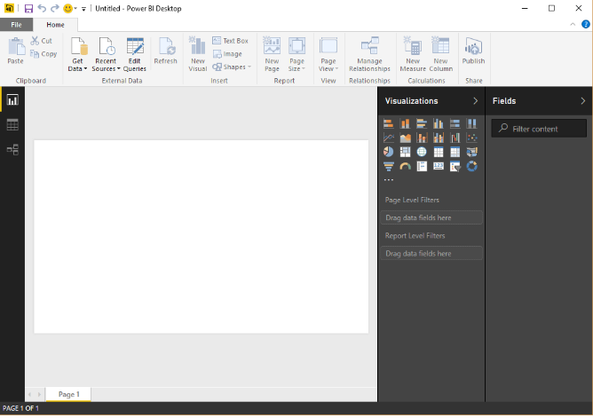
Prepare
Explore
Report
Share &
collaborate
Notes:
The page appears to look like this

Slide 17
The Report view has five main areas:
5
1
2
3
4
6
1. Report View – Click to enter Data View or the page where you are making the report
2. Data grid – where you find your table
3. Relationship view – where you can find if any relationship exists in your dataset
4. Visualisation pane – to add visuals to your report
5.Fields – wherein you have all the tables you are working on
6. the Home ribbon

Slide 18
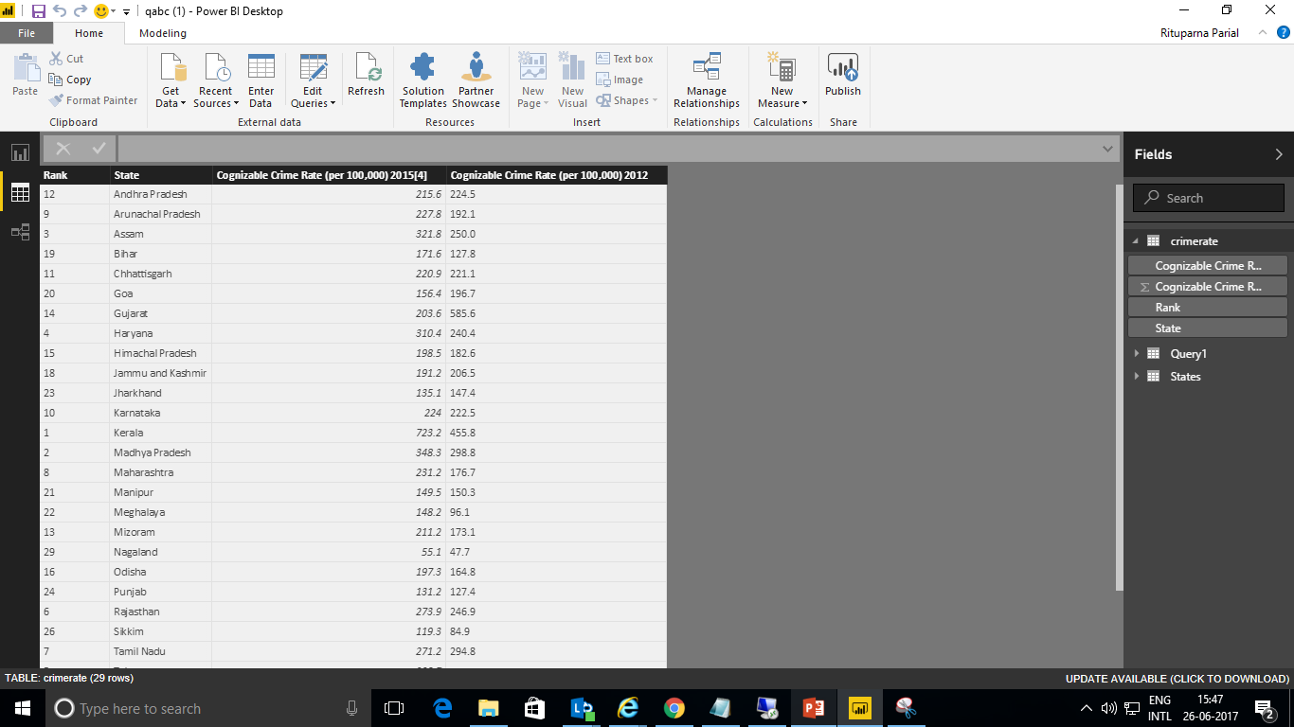

Data View in Power BI Desktop
3
5
1. Data View icon – Click to enter Data View.
2. Data Grid – Shows the selected table and all columns and rows in it. Columns hidden from Report View are greyed out. You can right-click on a column for options.
3. Modeling ribbon – Manage relationships, create calculations, change data type, format, data category for a column.
4. Formula bar – Enter DAX formulas for Measures and Calculated columns.
5. Search – Search for a table or column in your model.
6. Fields list – Select a table or column to view in the data grid.
1
4
2
6

Slide 19
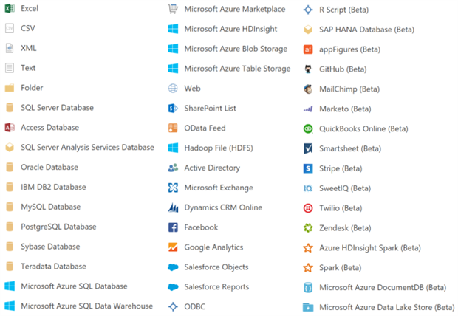
GET DATA FROM FOLLOWING FIELDS IN POWER BI
Notes:
As we can see we have a get data section from where we can import data from whatever location we need. This has a wide range from directly fetching data from the web, to sql server database , to directly getting an excel sheet ,csv file and many more.

Slide 20
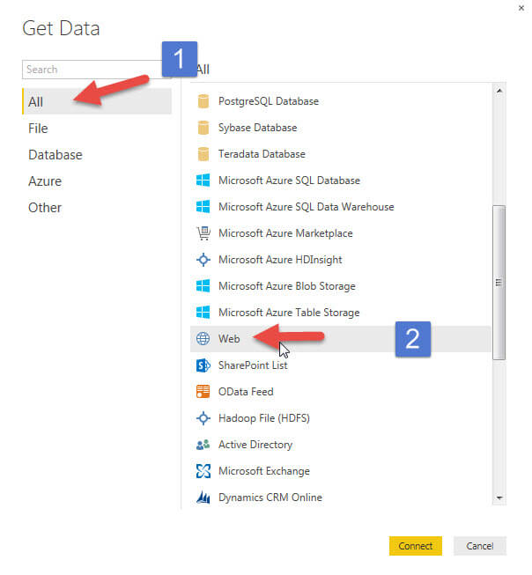
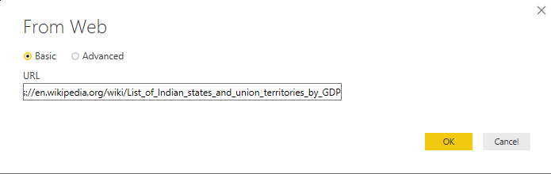
To get data from web
3
Click on OK
Notes:
Now suppose we want data from the web and we want to analyse different states on the basis of their gdp
Select Get Data > Web and paste the address.
Eg : https://en.wikipedia.org/wiki/List_of_Indian_states_and_union_territories_by_GDP
When you select OK, the Query functionality of Power BI Desktop goes to work. Query contacts the Web resource, and the Navigator window returns what it found on that Web page. In this case, it found the tables selected have data and the overall Web Document. We’re interested in the table, so we select it from the list. The Navigator window displays a preview.

Slide 21
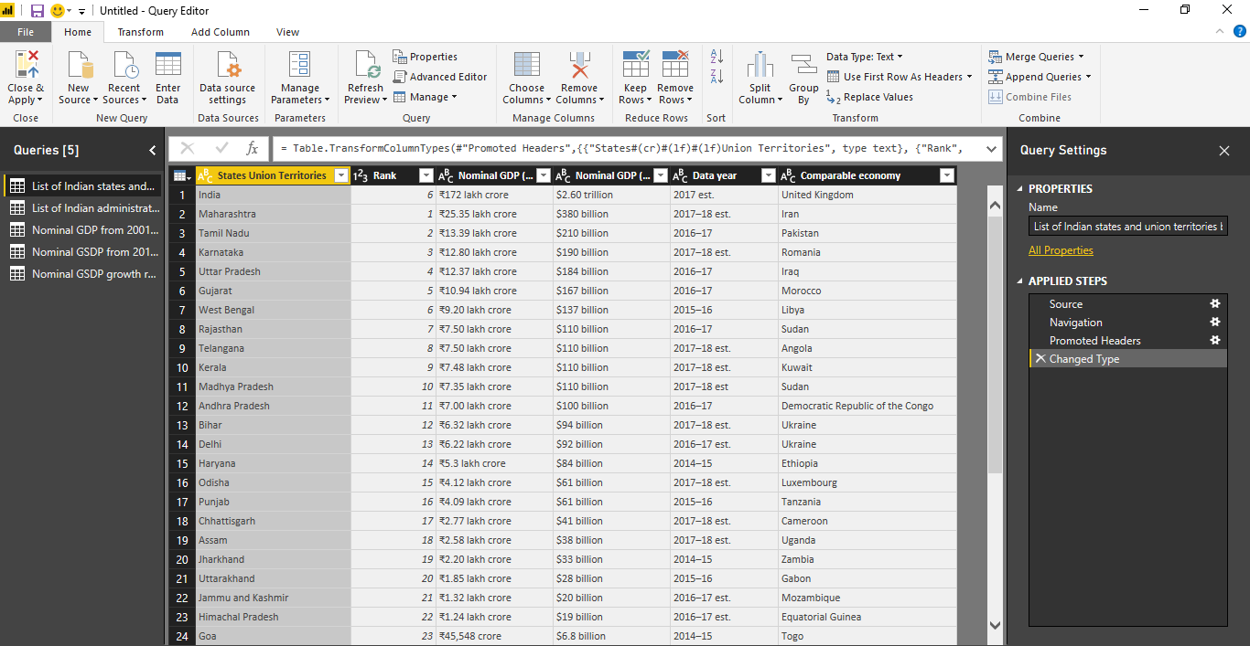
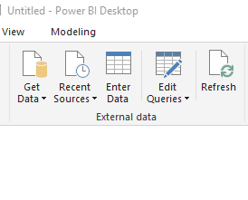
Now to edit your tables click on the edit query option
When we select Edit, Query Editor launches and a representative view of the table i.s presented.
The Query Settings pane is displayed (if it’s not, you can select View from the ribbon, then Show > Query Settings to display the Query Settings pane). Here’s what that looks like.
Notes:
Now that we’ve connected to a data source, we need to adjust the data to meet our needs. Sometimes adjusting means transforming the data – such as renaming columns or tables, changing text to numbers, removing rows, setting the first row as headers, and so on.

Slide 22
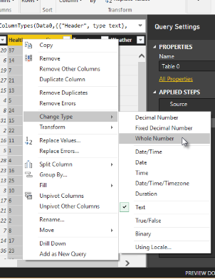
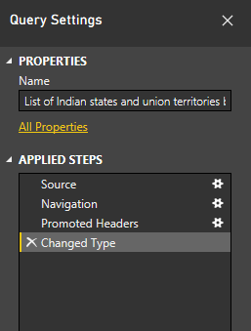
When you are making changed to the data query editor takes your commands one by one and does the needful without disturbing original data these steps are shown in query settings pane
Notes:
To change data type just right-click the column header, and select Change Type > Whole Number to change the data type. If we needed to choose more than one column, we could first select a column then hold down SHIFT, select additional adjacent columns, and then right-click a column header to change all selected columns. You can also use CTRL to select non-adjacent columns.
You can also change, or transform, those columns from text to header by using the Transform ribbon. Here’s the Transform ribbon, with an arrow pointing toward the Data Type button, which lets you transform the current data type to another.
Note that in Query Settings, the Applied Steps reflect the changes that were made. If I want to remove any step from the shaping process, I simply select that step, and then select the X to the left of the step.

Slide 23
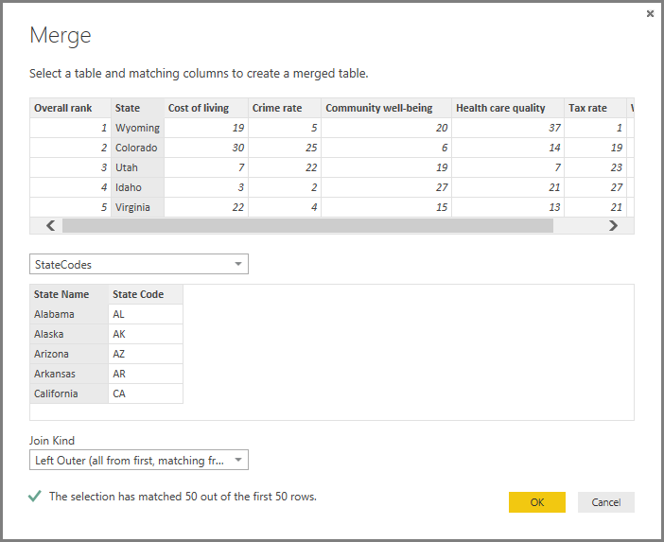
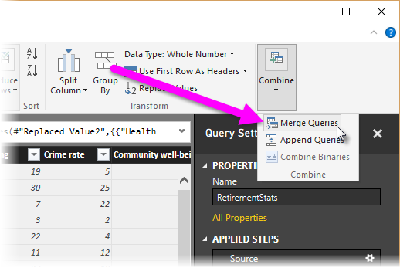
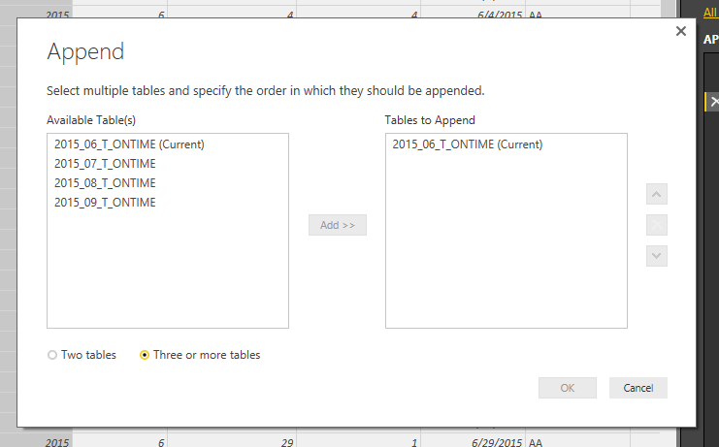
COMBINING QUERIES There are two primary ways of combining queries – merging and appending.
MERGING
APPENDING
When you have one or more columns that you’d like to add to another query, you merge the queries
When you have additional rows of data that you’d like to add to an existing query, you append the query
Notes:
Merge : A NewColumn is created at the end of the query, which is the contents of the table (query) that was merged with the existing query. To expand the merged table, and select which columns to include, select the expand icon ( ). The Expand window appears.
“similar for Append

Slide 24
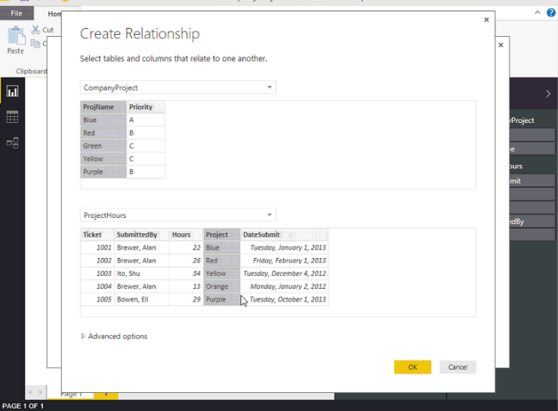
How to create relationship between two tables in Power BI
Create a relationship manually
On the Home tab, click Manage Relationships > New
In the Create Relationship dialog, in the first table drop-down list, select a table, and then select the column you want to use in the relationship.
In the to second table drop-down list, select the other table you want in the relationship, then select the other column you want to use, and then click OK.
Notes:
REF “: https://powerbi.microsoft.com/en-us/documentation/powerbi-desktop-create-and-manage-relationships/

Slide 25
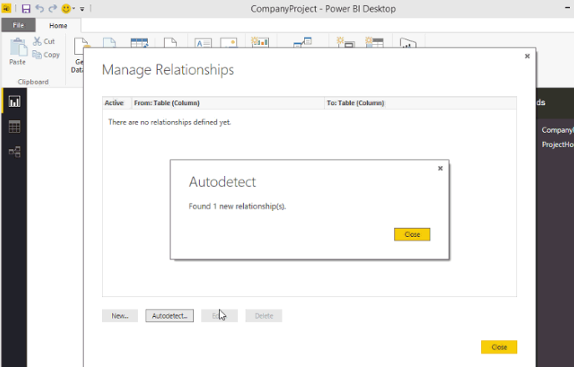
AutoDetect during loading
ON THE HOME TAB, CLICK MANAGE RELATIONSHIPS >AUTODETECT

Slide 26
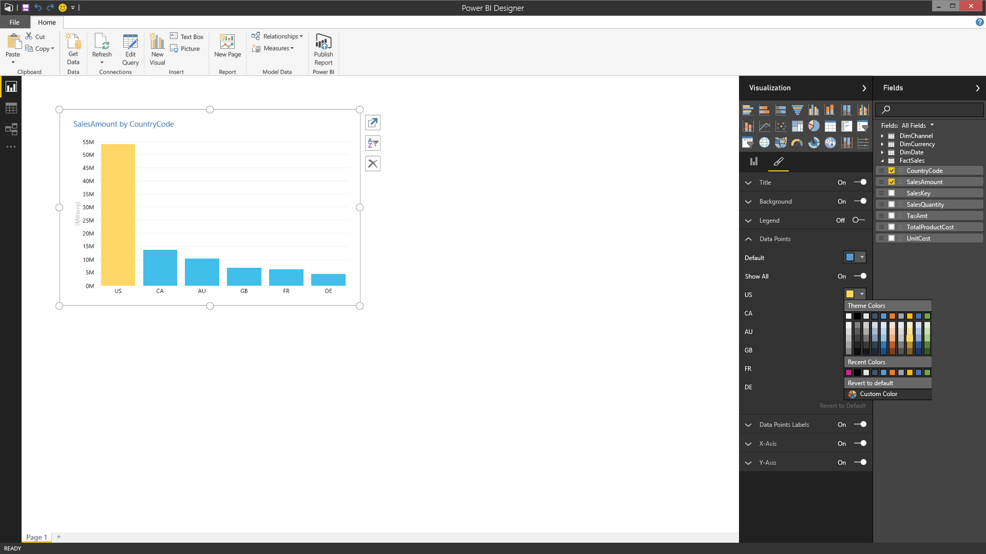
Power BI Desktop
Explore your data with freeform, drag and drop canvas
Explore data in a variety of ways and across multiple visualizations
Select data elements and sort data
Filter data and use cross-filter capabilities
Drill into and across datasets
Pivot and slice data
Change visualization types
Date sort and filters including Min & Max functions
Ability to refresh all views with a single click
Copy/Paste queries to/from Excel
Select, transform and mashup data via a freeform, drag-and-drop canvas
Prepare
Explore
Power BI Desktop allows you to explore your data and create insightful visualizations on a freeform canvas
Report
Share &
collaborate
Notes:
The reporting step is where the visual data exploration enabled by Power BI Desktop really comes to life
Note: you can move directly from connecting to (importing) data to reporting – data preparation, modeling, and analysis are optional intermediate steps. Because Power BI Desktop automatically creates a data model for you upon data import, you can immediate generate reports
You can select, transform and mashup data via a freeform, drag-and-drop canvas
Explore data in a variety of ways and across multiple visualizations
Select data elements and sort data
Filter data, leveraging cross-filter capability
Drill into and across datasets
Pivot and slice data
Change visualization types

Slide 27
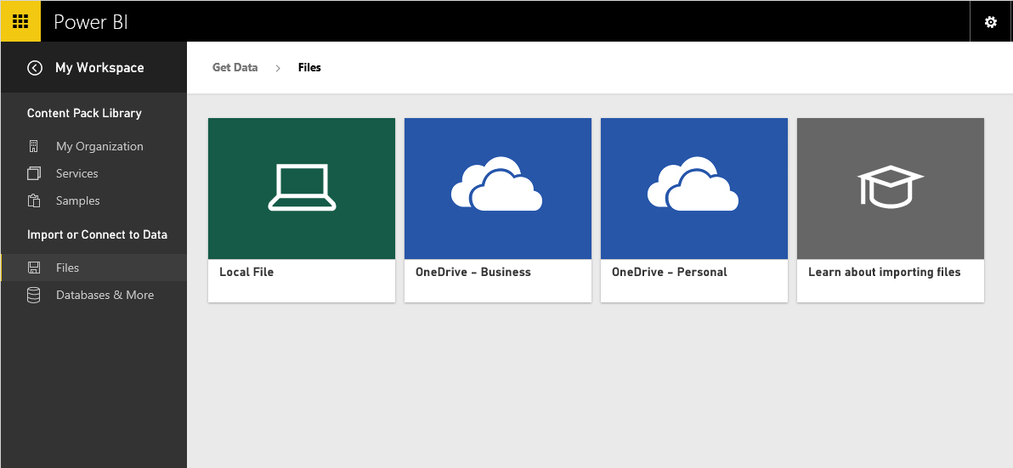
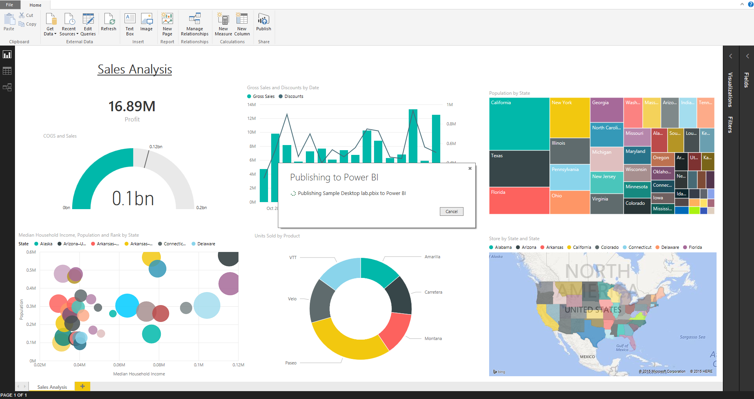
Power BI Desktop
Share reports, visualizations and data with a broad audience
Prepare
Save Power BI Desktop report files and easily publish them to Power BI
Share as appropriate with other Power BI users in your organization
Changes to dashboards automatically sync across all users
Copy table, cells or columns to clipboard
Explore
Import Power BI Desktop file in Power BI service
Report
Share &
collaborate
Publish from Power BI Desktop to Power BI service
Notes:
Once you are ready to publish your report and the visualizations within it, you can surface it to a broader audience by publishing to the Power BI service
Save the Power BI Desktop file, then go into the Get Data interface on powerbi.com to upload the report and share it with others
This enables you to give Power BI users access to richer data models and reports than they could create on their own

Slide 28
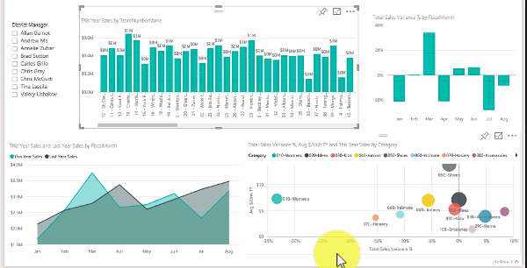
Visualisation

Slide 29
Types of Visualisations
Area charts: Basic (Layered) and Stacked
Bar and column charts , line charts
Cards: Multi row
Cards: Single row
Pie charts, gauge charts, donut charts
Maps and tables /matrix
etc.

Slide 30
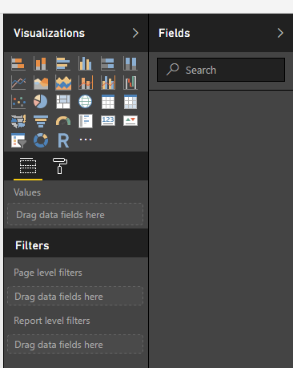
Adding a visualization in Power BI
From the pane called Visualization on the right-side of your desktop Power BI click on the desired visualisation and the from the fields column select the data fields you want to see
Mix and match
Select different visualisations and apply the one you find the best for the data
Then click on the blank side of the page to pin it to the dashboard so as to start another visualisation on different set
Notes:
HOW TO ADD CUSTOM VISUALS IN POWER BI : https://powerbi.microsoft.com/en-us/documentation/powerbi-custom-visuals-use/
https://store.office.com/search.aspx?category=Data%2BVisualization%2B%252b%2BBI&sourcecorrid=8d64c608-a4f3-4c80-8d2c-24edd529aa12&clickedfilter=OfficeProductFilter%3APowerBI&productgroup=PowerBI

Slide 31
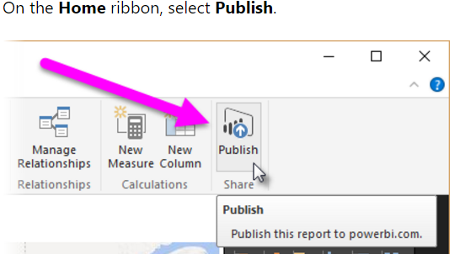
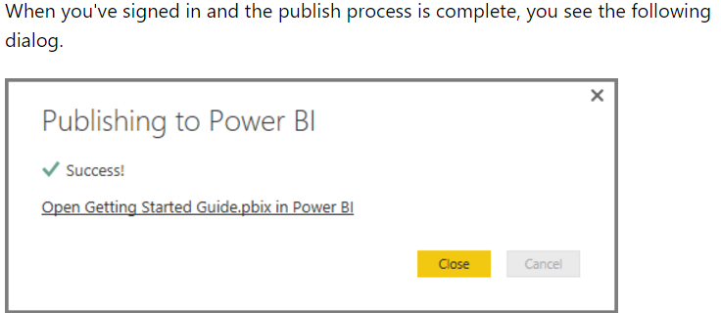
PUBLISHING DATA ON POWER BI WEB
After you have made your report save it .
It shall be saved as .pbix file
You should have a power bi account only
then you can publish

Slide 32
Here are a few reports made by me in Power BI desktop

Slide 33
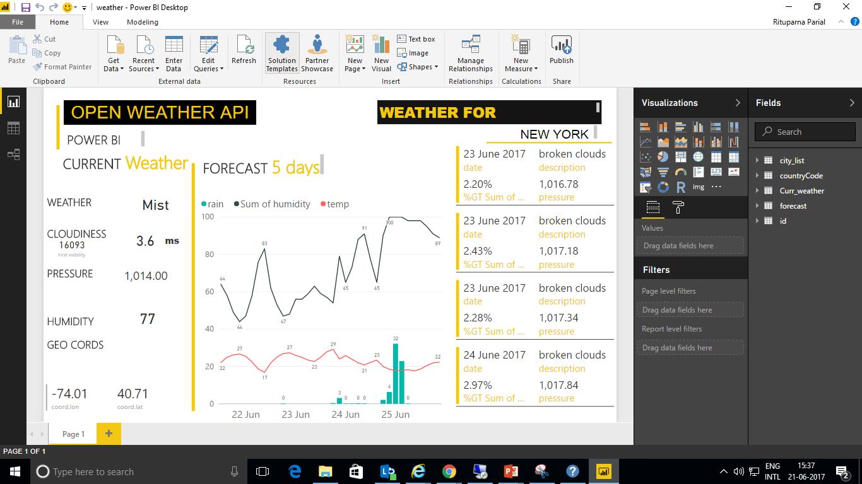
Notes:
In this particular report I have Created a Weather Dashboard with Power BI and API , wherein I have connected to the OpenWeatherMap API, through json, and build a dashboard including current weather and forecast for a certain city(New York).
The reference link from where I got all the help is : https://www.biitlog.com/power-bi-weather-api/

Slide 34
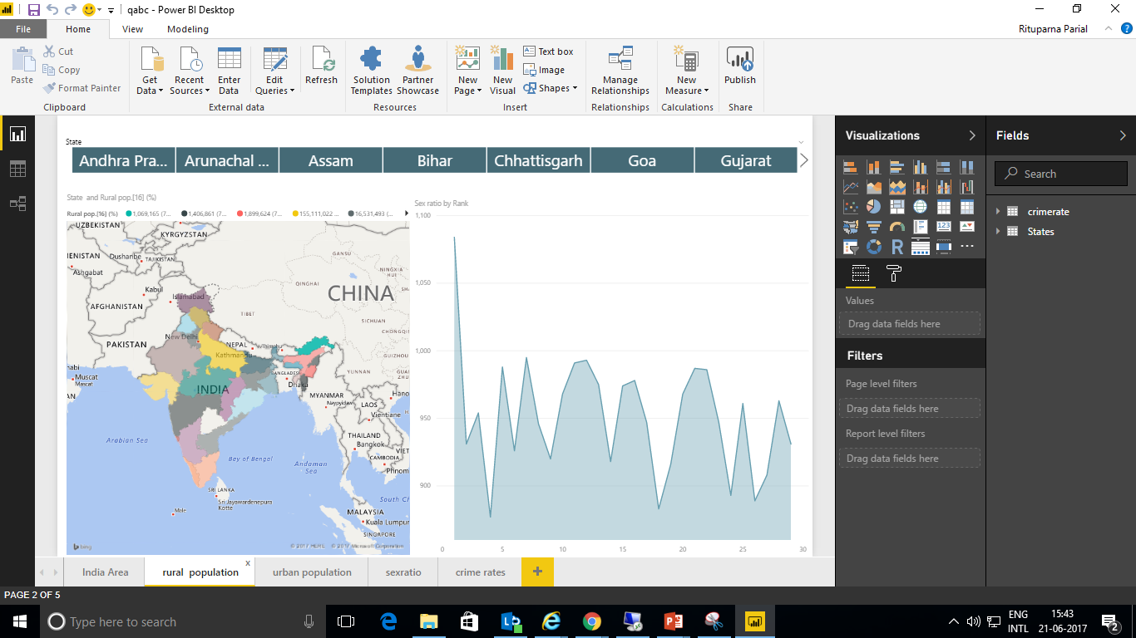
Notes:
This was one of my first reports as earlier I showed a tutorial wherein we can take data from the web here similarly we are fetching data over web from wikki , for my convenience I took Populations of states in india and merged it with another data set Crime Rates in states in india.

Slide 35
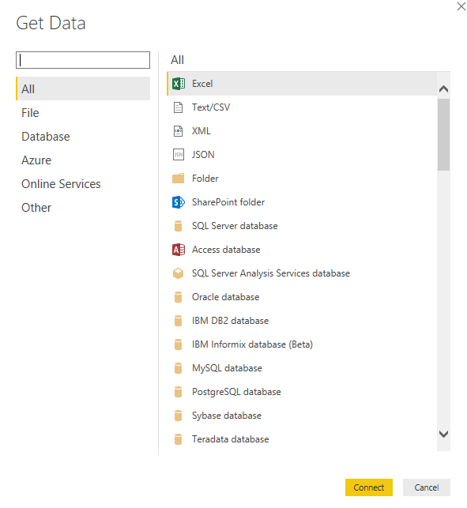
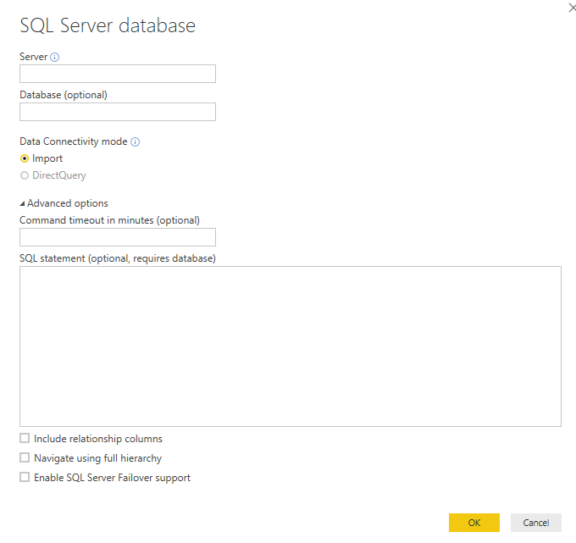
Suppose you want to fetch data from server :
Notes:
“To fetch data we need specifically the Server name, the name of the database and the sql query of the particular table or tables we are importing .
There are two types of connectivity modes Import and DirectQuery , the basic difference between both is that import makes a copy & gets the data whereas DirectQuery takes the directly and makes the visualisation .
For more details : https://powerbi.microsoft.com/en-us/documentation/powerbi-desktop-use-directquery/

Slide 36
Example of such reports
NOTE : The following reports made by me take data from sql server (ssrs) and using visualisation we convert them into power bi reports.

Slide 37
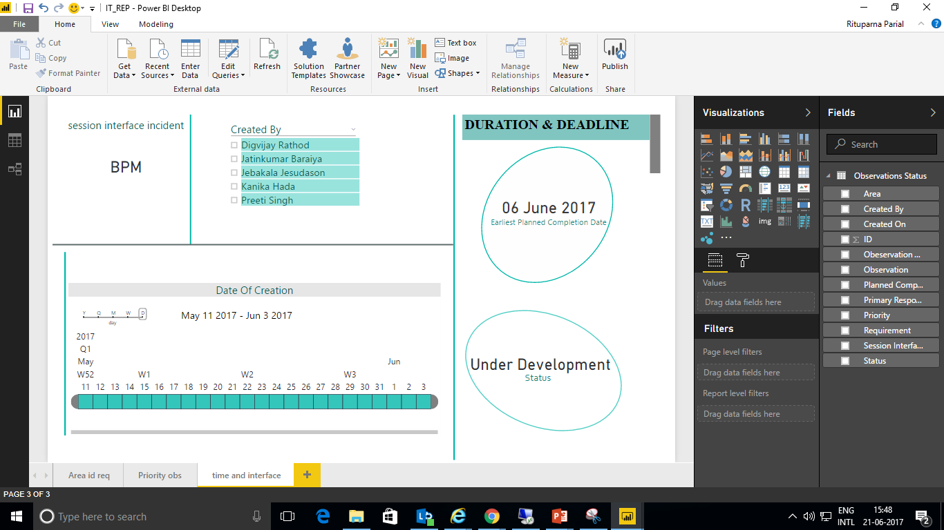
Notes:
In this particular report the data was taken from the sql database .

Slide 38
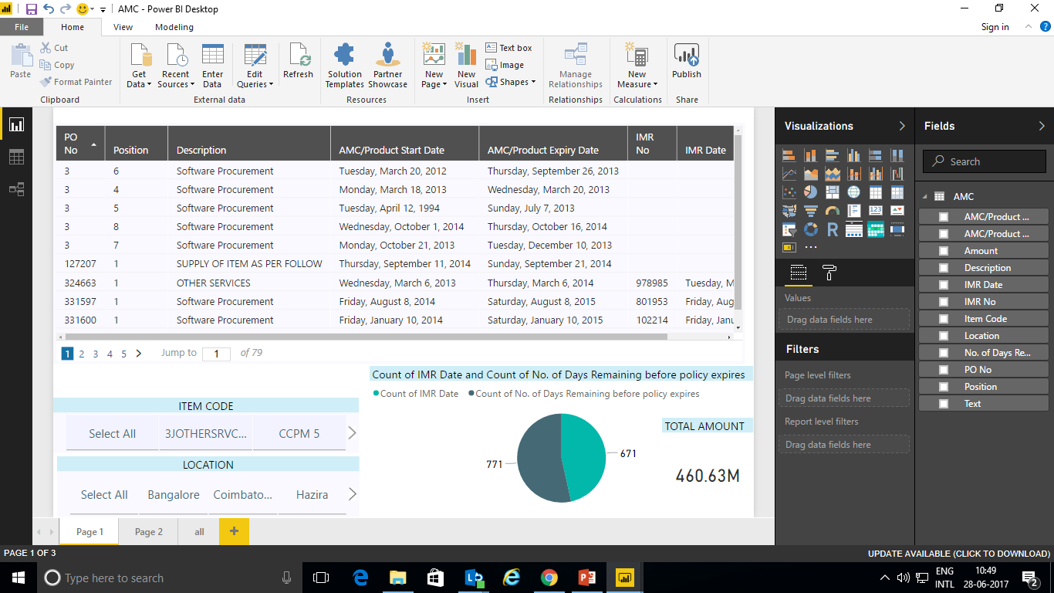
Notes:
AMC (SQL database)

Slide 39
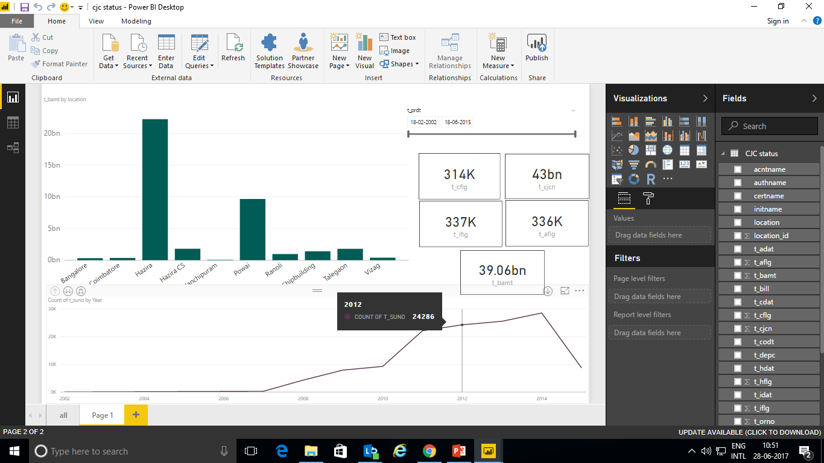
Notes:
cjc status (sql database)

Slide 40
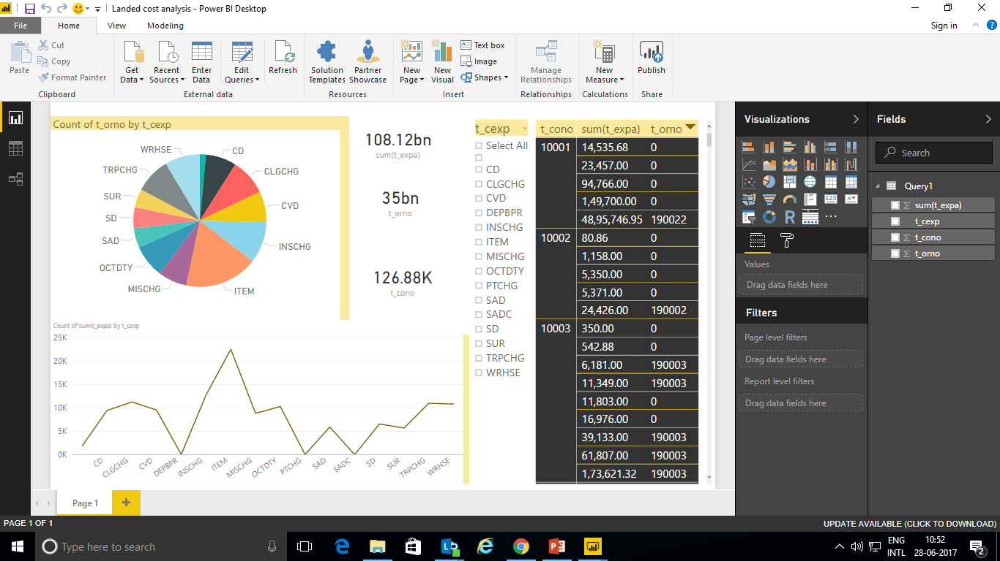
Notes:
Land cost analysis (sql database)

Slide 41
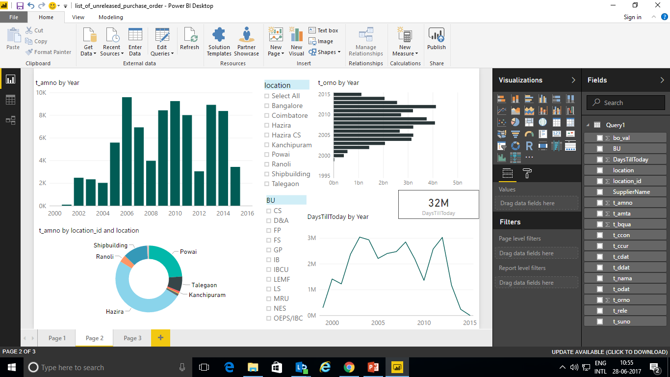
Notes:
List of unreleased purchase order (sql database)

Slide 42
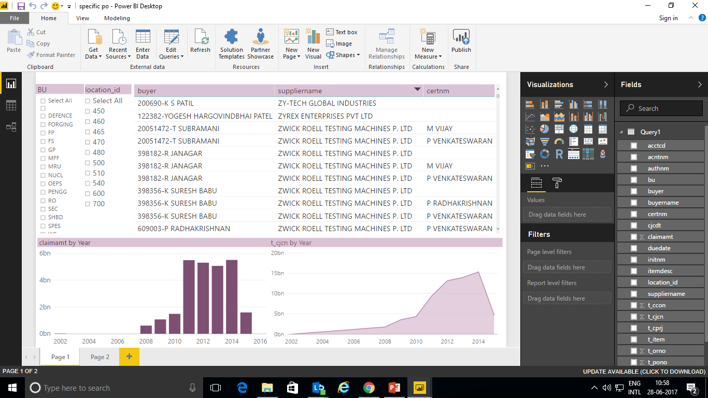
Notes:
Specific po (sql database)

Slide 43
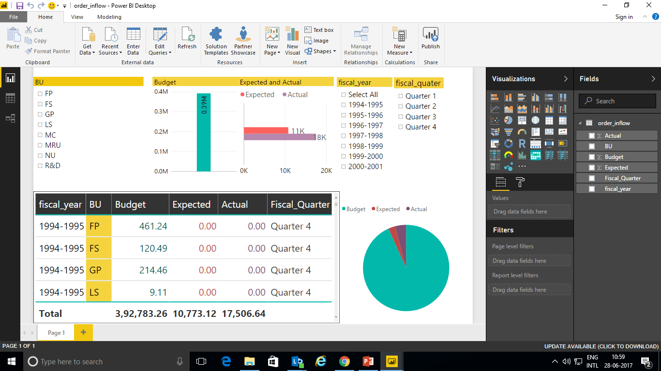
Notes:
Order inflow(sql database)

Slide 44
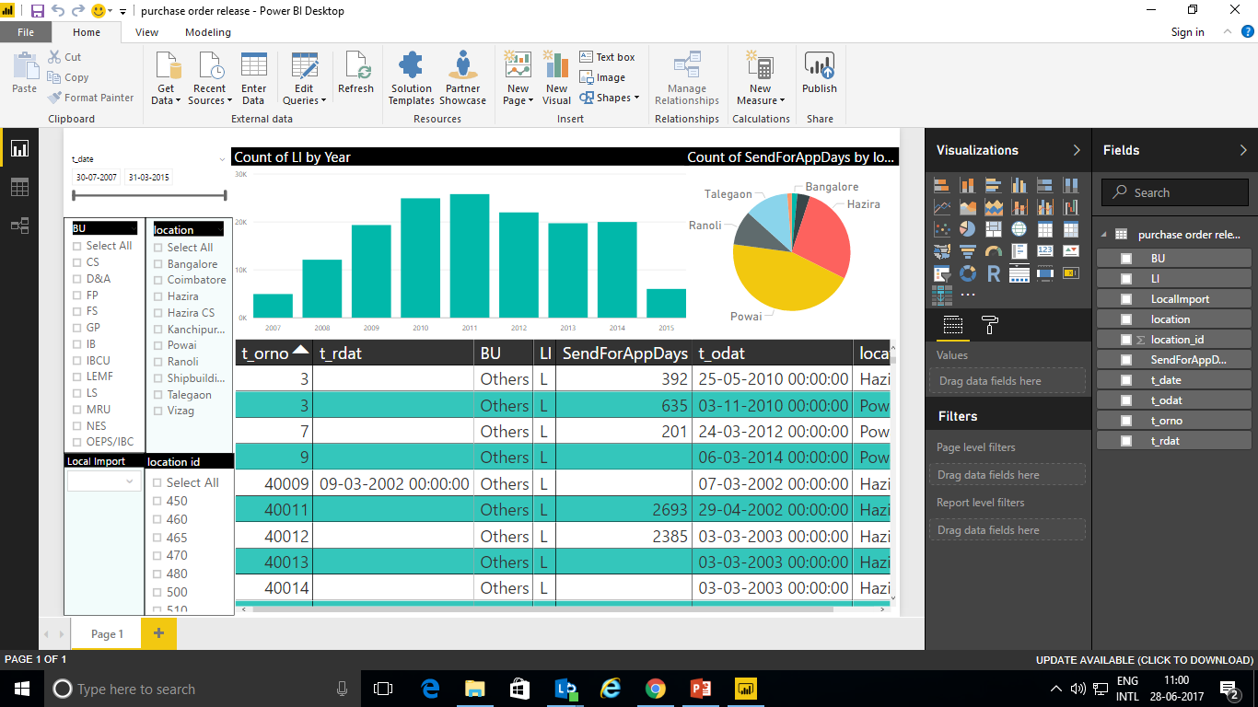
Notes:
Purchase order release (sql database)

Slide 45
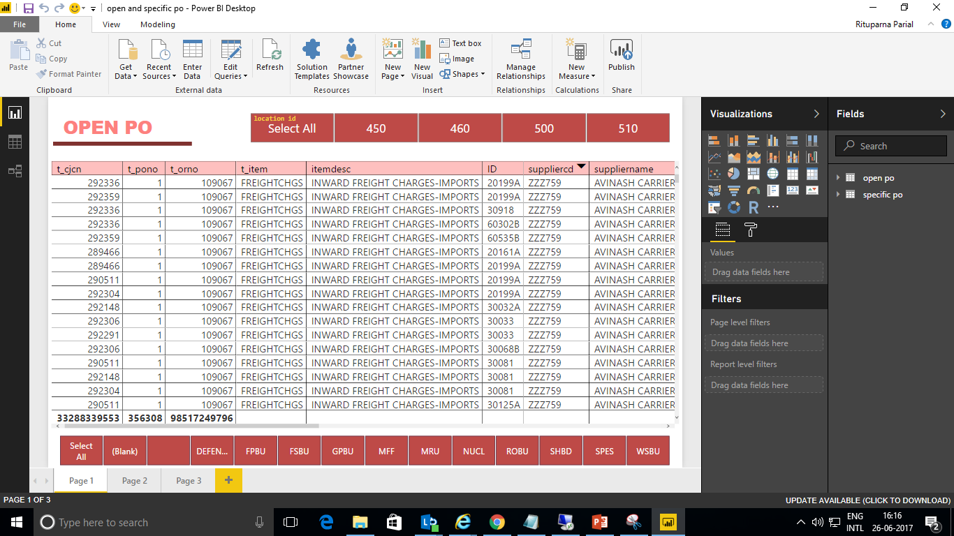
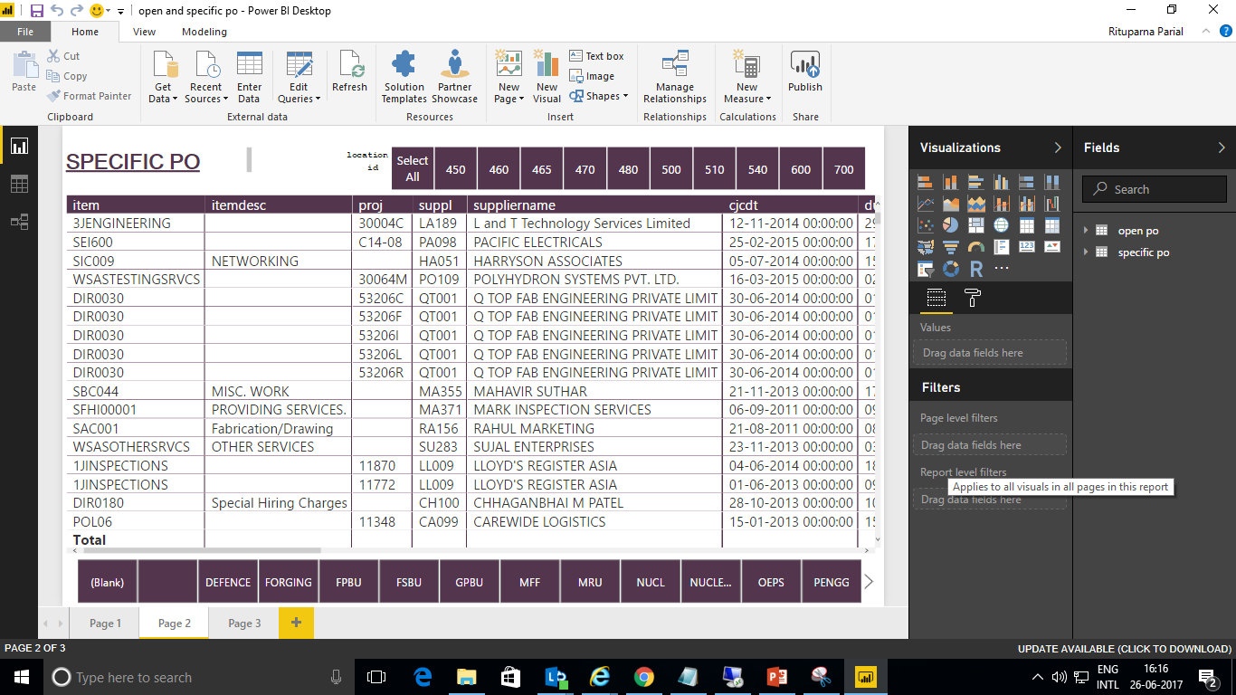

Slide 46
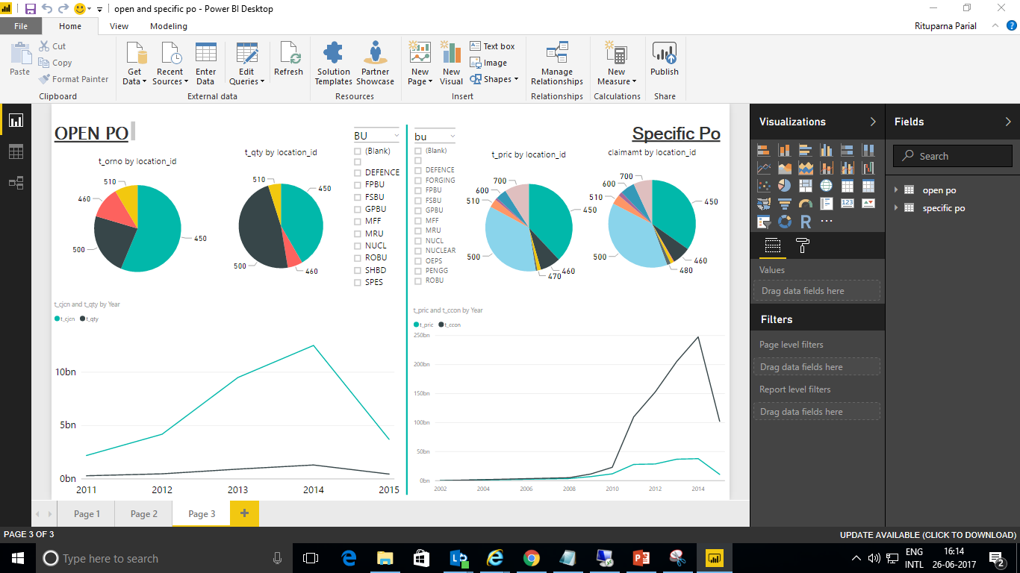

Slide 47
A Few more features :
To enter data directly into Power BI : https://powerbi.microsoft.com/en-us/documentation/powerbi-desktop-enter-data-directly-into-desktop/
Running R Scripts in Power BI Desktop : https://powerbi.microsoft.com/en-us/documentation/powerbi-desktop-r-scripts/
For entire Tutorial : https://powerbi.microsoft.com/en-us/guided-learning/

Slide 48
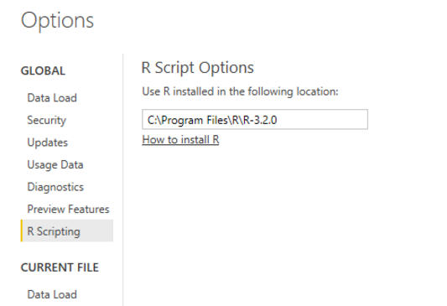
Using R with Power BI
Installing R
https://mran.revolutionanalytics.com/download/
https://cran.r-project.org/bin/windows/base/
To enable R visuals, select File > Options and settings > Options
Notes:
Because it's a programmable environment that uses command-line scripting, you can store a series of complex data-analysis steps in R. That lets you re-use your analysis work on similar data more easily than if you were using a point-and-click interface.

Slide 49
R script as data source in Power BI Desktop
Import
Formatting &amp; Sorting
Filtering
Merging
Transformation
First we import the data which is stored in the form of CSV file i.e. in the default folder of R installation which is in Documents folder however you can specify custom path using double backslashes for example C:\\Users\\abc\\Desktop\\AU_Import.csv. documents
Majority of times not all the data available is useful and you may only need the small subset of data from the actual file. Here we are only interested in columns Frequency, Commodity, Time and Value. Also changing column names to more meaningful ones.
Also we filter the only required data & then merge it with another table and in the end we transform it
Notes:
THE CODE IS PASTED IN THE FOLDER named R & POWER BI in the name code
Also to import data in your power bi you need to paste your csv file from the folder to the folder where R is installed . (by default documents)
Ref : https://community.powerbi.com/t5/Community-Blog/R-script-as-data-source-in-Power-BI-Desktop/ba-p/43341

Slide 50
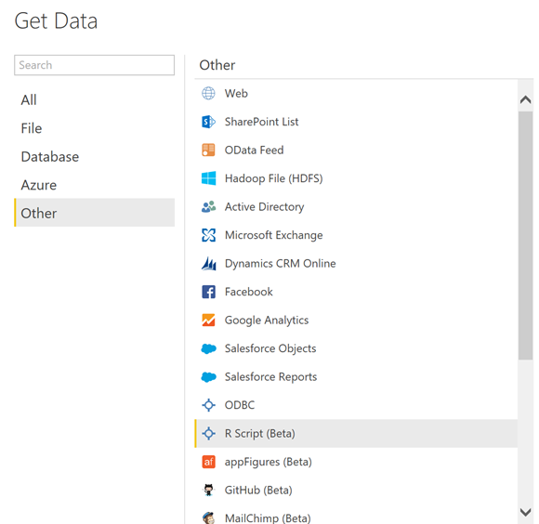
Building dashboard
click on the Get Data link and then select the “R Script (Beta)” data source option

Slide 51
To import data into Power Bi using R
Copy and paste below code that will import contents of csv file into a table called input and see in preview navigator
CODE :
#use read.csv method to import data
input <- read.csv("~//AU_Import.csv", stringsAsFactors=FALSE, sep=",")

Slide 52
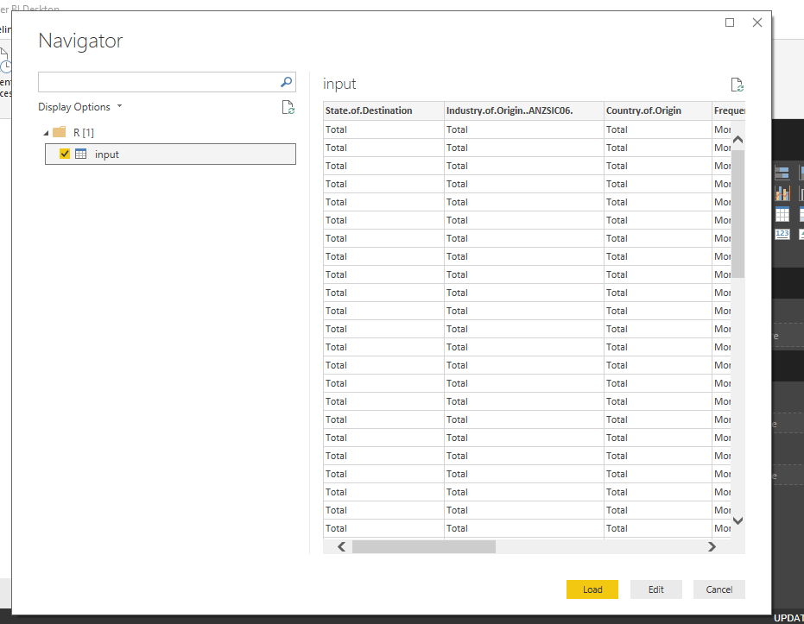

Slide 53
Formatting & Sorting
#change data type of Date column to date
input$Date <- as.Date(input$Date)
#sort by date column
input[order(Date),]
#excluding unwanted columns and change column names
keepcolumns <- c("State.of.Destination"," Frequency"," Commodity.by.SITC"," Time","Value")
input <- input[,keepcolumns]
colnames(input)[3] <- c("Commodity")
colnames(input)[1] <- c("State")
colnames(input)[5] <- c("ImportValue")
#extract monthname
input$Date <- paste(substr(input$Time,nchar(input$Time)-3,nchar(input$Time)), paste(match(substr(input$Time, 1,3), month.abb), "01", sep="-"), sep="-")
#Time column no longer required
attach(input)
input$Time <- NULL
Filtering
& Merging
#Use subset function to exclude rows
input <- subset(input, Commodity!="TOTAL" & State!="No state details" & State!="Total")
#Use omit function to remove null rows
input <- na.omit(input)
#Use merge function to merge two dataframes
Combined <- merge(input,output,by=c("State","Frequency","Commodity","Date"))
Notes:
As we’re only interested in state level data, using subset function we can filter out rows that is not useful. Using ‘!=’ operator and ‘&’ operator to specify multiple conditions we are going to excluded rows where there is no state details, commodity totals and state totals. Using Omit function will remove all rows where value is null.
Finally we want to merge these two data frames into single one to be used in power bi. We will use merge function for that and specify columns we want to perform match on.

Slide 54

Notes:
AFTER PASTING FINAL CODE IN GET DATA>R SCRIPT

Slide 55
Here are a few basic charts using R visualisation
Notes:
http://ggplot2.tidyverse.org/reference/theme.html

Slide 56

code
Notes:
histogram chart: from R visual
attach(dataset)
hist(ExportValue, col=“Red")

Slide 57


Here I have used ggplot2 library :
Ref:
http://tutorials.iq.harvard.edu/R/Rgraphics/Rgraphics.html

Slide 58

Notes:
library(ggplot2)
ggplot(data=dataset, aes(x=ImportValuePct, y=Year,size='qsec')) + geom_line(aes(color="red")) + ggtitle("IMPORT VALUE BY YEAR") + theme(legend.position = "none") + theme_bw() +
theme(panel.grid.major = element_line(colour = "#d3d3d3"),
panel.grid.minor = element_blank(),
panel.border = element_blank(),
panel.background = element_blank(),
plot.title = element_text(size = 15, family = "Tahoma", face = "bold"),
text=element_text(family = "Tahoma"),
axis.title = element_text(face="bold"),
axis.text.x = element_text(colour="black", size = 13,face="bold"),
axis.text.y = element_text(colour="black", size = 13,face="bold"),
axis.line = element_line(size=0.5, colour = "black"))

Slide 59
Enhanced Charting with R visuals :

Slide 60

Notes:
Open R download your library
“https://cran.r-project.org/doc/contrib/Short-refcard.pdf
https://personality-project.org/r/r.commands.html

Slide 61

First install the library if it is not pre installed only then run the code
Notes:
install.packages(“ggplot2") // in our case

Slide 62


Slide 63



Notes:
Next, we will need to create a cumulative calculated column measure using DAX. On the home ribbon click the New Measure button and enter the following DAX expression.

Slide 64


Slide 65




Slide 66


Slide 67

Notes:
REF : https://powerbi.tips/2016/09/digging-deeper-with-r-visuals-for-powerbi/
This is an area plot in the background, a bar chart as a middle layer and dots for each bar. The use case for this type of plot would be to plot sales by item number, sales are in the dark blue bars, and the price is shown as the light blue dots. The area behind the bars represent a running total of all sales for all items. Thus, when you reach item number 10, the area represents 100% of all sales for all items listed.

Slide 68

POWER BI WEB
Notes:
After we click publish icon on Power BI desktop (which we can do only if we have an power bi account) then we have to open Power BI Web to see the published data. Also in Power BI web we can Live stream data .

Slide 69

POWER BI WEB VERSION
Notes:
This is the page that opens when we login to our power bi account

Slide 70

About Power BI web:
you can get insights from your data in no time.
All your data, wherever it is
The Published data from desktop goes here
Be informed: always real time
Ask questions, get answers
Curated content, just for your organization
End chaos: Everyone on the same page
Make data-driven decisions, from anywhere
Integrate with Power BI

Slide 71
DEMO

Slide 72

Building a real time iot dashboard

Slide 73
REFER to video and reference links
Notes:
REF: https://powerbi.microsoft.com/en-us/blog/using-power-bi-real-time-dashboards-to-display-iot-sensor-data-a-step-by-step-tutorial/
https://www.pubnub.com/blog/2016-08-31-realtime-charts-and-graphs-with-microsoft-power-bi/
https://www.pubnub.com/developers/realtime-data-streams/sensor-network/

Slide 74

Notes:
This was the dashboard I created

Slide 75

Visualize your Microsoft Azure Enterprise Data with Power BI

Slide 76
Visualize real-time sensor data from Azure IoT Hub using Power B
With the release of the Microsoft Azure Enterprise content pack for Power BI, you can now quickly import and analyse your Azure consumption data in Power BI
We can gain insights to into which departments, accounts, or subscriptions are consuming the most or the High velocity(volume , variable) live streaming sensor data generated by sensors in factories.
To understand better here's an example of how we can visualise sensor data in Power BI using azure

Slide 77
DEMO

Slide 78

Overview of the project :
`Here instead of Raspberry pi I have used a raspberry pi online simulator to fetch the real time data , following steps are to be followed:
Setting up device
Creating iot hub in Microsoft Azure enterprise
Registering pi to iot hub
Run a sample application on Pi to send simulated sensor data to your IoT hub
Setting up Stream analytics in Microsoft Azure enterprise

Slide 79
Connecting Raspberry Pi online simulator to Azure IoT Hub (Node.js)
https://docs.microsoft.com/en-us/azure/iot-hub/iot-hub-raspberry-pi-web-simulator-get-started

Slide 80

Notes:
IN Microsoft Azure after connecting to Iot hub this is how your screen appears

Slide 81

Notes:
Copy the primarykey

Slide 82

Notes:
Change shared access policies

Slide 83

Notes:
After connecting to Stream analytics

Slide 84

Notes:
Giving input to stream analytics

Slide 85

Notes:
Setting output for stream analytics

Slide 86

Notes:
Entering query in Stream analytics

Slide 87

Notes:
This is the Raspberry pi simulator here code works on NodeJS

Slide 88

Notes:
After data is sent it blinks LED

Slide 89

Notes:
After from Stream Analytics its set to Power BI sink then it appears on your Power BI web like this

Slide 90

Notes:
Output of the data live from the sensor
Every time we refresh we get updates data

Slide 91

Notes:
Its display for humidity and temperature

Slide 92

Excel using Power BI
Excel is the most commonly used analytical tool for business users – it truly is accessible to anyone. No other vendor has the ability to reach a billion users through tools they already know and use. Today Excel delivers end-to-end self-service BI functionality through capabilities such as Power Query, Power Pivot, Power View and Power Map. With the accessibility of Excel and proliferation of Office 365, we can lower the barrier of entry for businesses who want to take advantage of the benefits of business intelligence by putting the right analytics tools in everyone’s hands with no friction.

Slide 93


Slide 94
THANK YOU

